Slide 1

COMPUTER ORGANIZATION & ASSEMBLY LANGUAGE
Traffic Light Control System
An Assembly Language Approach to Intelligent Intersection Management
Abdul Wahid (243699)
Ahmad Murtaza (243653)
Supervisor: Mam Anum Aftab

Slide 2
PRESENTATION STRUCTURE
Contents
Project Overview
System Features
Operational Modes
01
02
03
Introduction, objectives, and development environment
Core traffic control, monitoring, and pedestrian safety
Normal, Emergency, Rush Hour, and Night modes
Technical Implementation
System Architecture
Testing & Results
04
05
06
Comprehensive validation and performance verification
Hardware interface, signals, and timing systems
Program flow, phase sequence, and data structures

Slide 3
GETTING STARTED
Project Overview
Development Environment
Language
Introduction
x86 Assembly (8086)
This project implements an intelligent traffic light control system using x86 Assembly language to manage four-way intersections with real-time monitoring and adaptive control.
Assembler
MASM / TASM
The system demonstrates low-level programming, hardware interfacing, and embedded system design principles through a practical, real-world application.
Platform
DOSBox Emulator
Project Objectives
Hardware Interface
Implement multi-mode traffic control
Port 4 (Traffic Light Control)
Integrate pedestrian safety features
Provide real-time monitoring
Memory Model
Demonstrate hardware interface concepts
Small (.model small)
Enable emergency response capabilities

Slide 4
CORE CAPABILITIES
System Features
Core Traffic Control
Real-Time Monitoring
Pedestrian Safety
Multi-Directional Management
Live Countdown Timers
Direction-Specific Signals
Independent North-South and East-West control
ALL CROSS
Synchronized signal transitions
NS: 5s EW: 5s
All-red phase only
All-red clearance phase between cycles
Updates every second during green phases
NS CROSS / EW CROSS
Color-coded in green (0Ah) for visibility
Direction-specific green
Signal States
Positioned at top-right corner of display
STOP
NS Green
All Yellow
Red signal warning
EW Red
Transition
Statistics Dashboard
EW Green
All Red
156
1,248
Manual Crossing Request
NS Red
Safety
Cycle Counter
NS Cars
P
892
2/sec
Key
EW Cars
Rate
Adds +3 seconds to current green phase
Auto-denied during inappropriate phases

Slide 5
OPERATIONAL FLEXIBILITY
Operational Modes Overview
Normal Mode
Emergency Mode
Balanced Traffic Flow
Immediate Response
Equal green time for all directions
Clear path for emergency vehicles
5s
5s
All lights flash yellow (0.5s)
NS Green
EW Green
Continuous audio beeping
2s
5s
All traffic must stop
Yellow
All Red
19s
Key: E
Total Cycle
Default
Rush Hour Mode
Night Mode
Heavy Traffic Optimization
Low-Traffic Operation
60% more green time for main road
Reduce unnecessary waiting
8s
3s
All lights blink yellow (1s)
NS Green
EW Green
Treat as all-way stop
3s
3s
Proceed when safe
Yellow
All Red
17s
Key: M
Optimized Cycle
Key: R

Slide 6
MODE 01
MODE 02
Normal Mode
Emergency Mode
19-Second Cycle Breakdown
Purpose
0-5s
All Red
Provide immediate response for emergency vehicles, ensuring rapid clearance of intersection traffic.
5-10s
NS Green
10-12s
All Yellow
Activation Behavior
12-17s
EW Green
17-19s
All Yellow
Flashing Lights
All lights flash yellow at 0.5s intervals
Key Characteristics
Traffic Capacity
Audio Alert
Continuous beeping for attention
Balanced traffic flow for both directions
10
NS Cars / Cycle
Traffic Protocol
Equal green time distribution (5s each)
All vehicles must stop immediately
Standard transition timing (2s yellow)
10
EW Cars / Cycle
Full pedestrian support with clear messages
Display Message
Exit Command
!!! EMERGENCY MODE ACTIVE - ALL TRAFFIC STOP !!!
N
Return to previous mode

Slide 7
ADVANCED OPERATIONS
Rush Hour Mode & Night Mode
MODE 03
MODE 04
Rush Hour Mode
Night Mode
Timing Configuration Comparison
Purpose
Phase | Normal | Rush Hour
NS Green | 5s | 8s (+60%)
EW Green | 5s | 3s (-40%)
Yellow | 2s | 3s
All Red | 5s | 3s
Designed for low-traffic periods to minimize delays and reduce unnecessary idling.
Operational Behavior
Blinking Yellow
All lights blink at 1s intervals
All-Way Stop
Vehicles proceed when safe
16
6
NS Cars / Cycle
EW Cars / Cycle
0s
D
vs 10 normal
vs 10 normal
Timer Display
Exit Command
Key Benefits
No countdown
Return to day
Optimized for peak traffic on main roads
Improved traffic throughput efficiency

Slide 8
UNDER THE HOOD
Technical Implementation
Hardware Interface
Video Memory Management
Output Port
Port 4
Memory Segment
0xB800
OUT 4, AX
Direct access to video memory for fast rendering
16-Bit Pattern Structure
Display Specifications
Bits 11-8
North-South Lights (RYG)
80×25
2 bytes
Text Mode
Per Char
Bits 7-4
East-West Lights (RYG)
Timing System
Signal Patterns
BIOS INT 15h (AH=86h)
030Ch
0861h
0492h
MOV AL, 0 ; Critical for DOSBox
NS Green
EW Green
All Yellow
MOV CX, 000Fh ; High word
0249h
0492h
MOV DX, 4240h ; Low word (1s)
All Red
Emergency
MOV AH, 86h
INT 15h
Custom Delay Procedures
DelayWithCountdown: All-red phase with beeps
DelayWithLiveTimer: Green phases with timer display

Slide 9
SYSTEM DESIGN
System Architecture
Program Flow
Phase Sequence
Data Structures
START
19-Second Complete Cycle
Mode Flags (DB)
Phase 0: All Red (0-5s)
emergency_mode DB 0
NS: Red | EW: Red | Pedestrians: ALL CROSS
night_mode DB 0
Initialization
rush_hour_mode DB 0
Phase 1: NS Green (5-10s)
NS: Green | EW: Red | Pedestrians: NS CROSS
Timers & Counters
Main Loop
Phase 2: All Yellow (10-12s)
ns_timer DB 0
Phase Cycle
NS: Yellow | EW: Yellow | Pedestrians: PREPARE STOP
ew_timer DB 0
Phase 3: EW Green (12-17s)
cycle_counter DW 0
Check Modes
NS: Red | EW: Green | Pedestrians: EW CROSS
Keyboard Input
Timing Configuration
Phase 4: All Yellow (17-19s)
ns_green_time DB 5
NS: Yellow | EW: Yellow | Pedestrians: PREPARE WALK
ew_green_time DB 5
Emergency/Night Loop (if active)
yellow_time DB 2

Slide 10
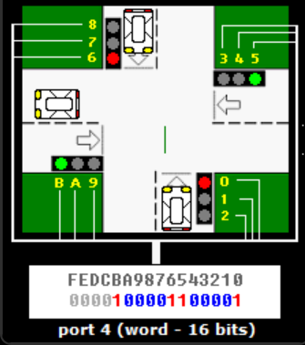
USER INTERACTION
User Controls & Interface
Keyboard Commands
Screen Layout
Key | Function | Description
E | Emergency | Activate emergency mode
N | Normal | Exit emergency mode
P | Pedestrian | Request +3s crossing time
R | Rush Hour | Toggle rush hour mode
M | Night | Activate night mode
D | Day | Exit night mode
ESC | Exit | Terminate program
TRAFFIC CONTROL SYSTEM
============================
Features
Case-insensitive input
Real-time detection (INT 16h)
Immediate response
Mode validation before switching

Slide 11
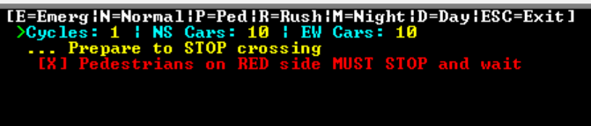
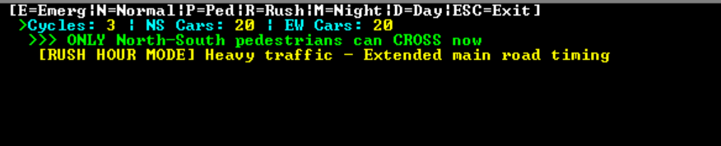

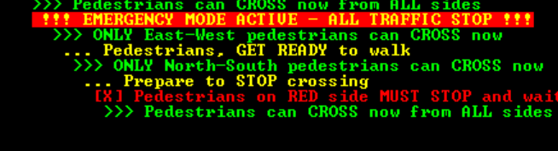
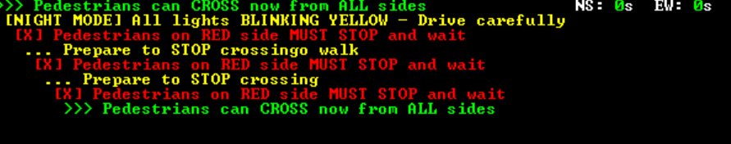
VALIDATION & PERFORMANCE
Testing & Results
01
Normal Operation Test
04
Rush Hour Mode Test
✓ PASS
✓ PASS
02
Emergency Mode Test
05
Night Mode Test
✓ PASS
✓ PASS
03
Pedestrian Request Test
Overall Result
Phase | Request | Result
NS Green | Press P | ✓ +3s granted
Yellow | Press P | ✓ Denied
All Red | Press P | ✓ Denied
Emergency | Press P | ✓ Denied
ALL TESTS PASSED
100% Success Rate
The system successfully validated all operational modes and edge cases, demonstrating robust performance and reliability.

Slide 12

PROJECT SUMMARY
Conclusion
Technical Achievements
Functional Features
Learning Outcomes
Low-level hardware interface (Port 4)
Four operational modes
Mastered x86 Assembly programming
Direct video memory manipulation
Pedestrian safety system
Understood hardware communication
Efficient timing using BIOS interrupts
Real-time monitoring
Learned real-time system design
Real-time input processing
Emergency response capability
Implemented state machine logic
Multi-mode state management
Adaptive timing (rush hour)
Applied traffic engineering concepts
Real-World Applicability
This system simulates actual traffic management principles and can serve as a foundation for embedded traffic control systems. The modular design allows for easy expansion and modification, demonstrating practical applications of low-level programming in critical infrastructure systems.
Developed by
Abdul Wahid & Ahmad Murtaza

